Slide 1

COMP 5350 / 6350 / 6356 Digital Forensics Spring 2019

Slide 2
Project #2

Slide 3
Project #2 Requirements
Create a report and presentation that highlights the capability of open source forensics tools
https://github.com/cugu/awesome-forensics/blob/master/README.md#tools
What must be addressed in the report and presentation?
What problem does this tool or framework solve?
What code base does the tool use?
What operating system does the tool focused on?
What are the benefits / drawbacks?
How can it be improved?
The tool / framework must be demonstrated during the presentation
3 Students / Team
Student Presentations
10 minutes each
18 April, 25 April
Report format same as Project #1

Slide 4
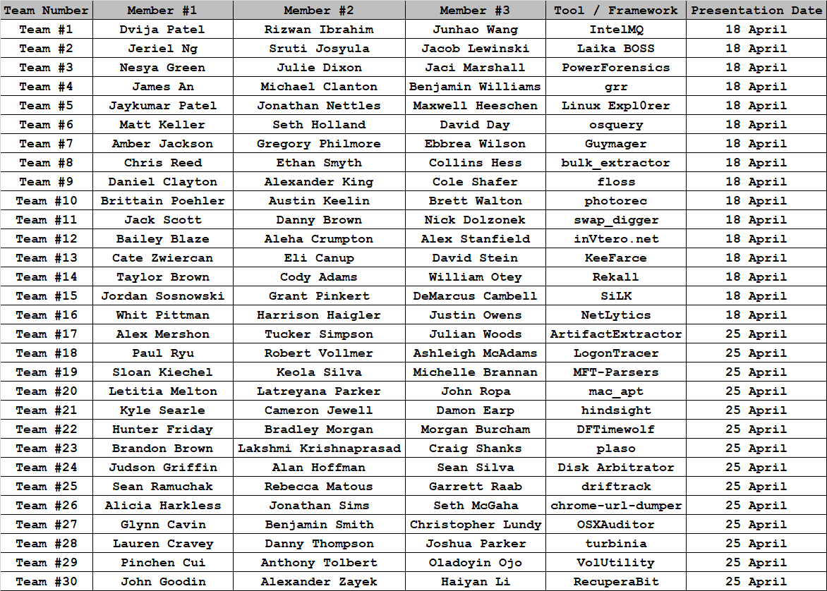
Project #2 Teams & Topics

Slide 5
Linux History and Development

Slide 6
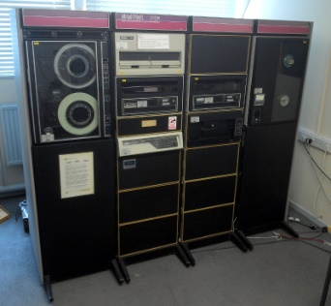
Linux Historical Timeline
1969
PDP developed at Bell Labs
1993
Ext2 File System
Linux kernel 0.99
1984
4.2BSD Released
2008
Ext4 File System
Linux Kernel 2.6.28
1982
UNIX System III
released
1991
First Linux Kernel Released 0.02
1983
UNIX System
Development Lab created
UNIX System V
released
1992
ext File System
Linux Kernel 0.96c
1988 POSIX.1
Published
1973
UNIX ported to C
2001
Ext3 File System
Linux Kernel 2.4.15

Slide 7
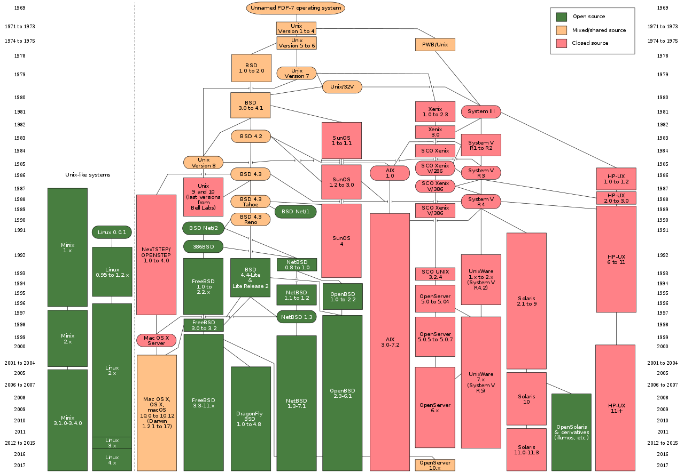
Unix History

Slide 8
Linux
Open source operating system (GPL)
Modification and redistribution of source code
The first version of Linux what released in 1991
Although not derived directly from Unix-based operating systems, Linux was developed to be functionally similar to Unix
Each Linux instance contains common components
Bootloader
Kernel
Shell(s)
Command Line Interfaces (CLI)
Graphical User Interface (GUI)
Optional
Applications

Slide 9

Linux Distributions
There are currently 280+ Linux distributions in use
Each Linux distribution combines different software, projects, and libraries
Pre-compiled and tested software packages known as repositories
A typical Linux distribution comprises a Linux kernel, GNU tools and libraries, a package management system

Slide 10
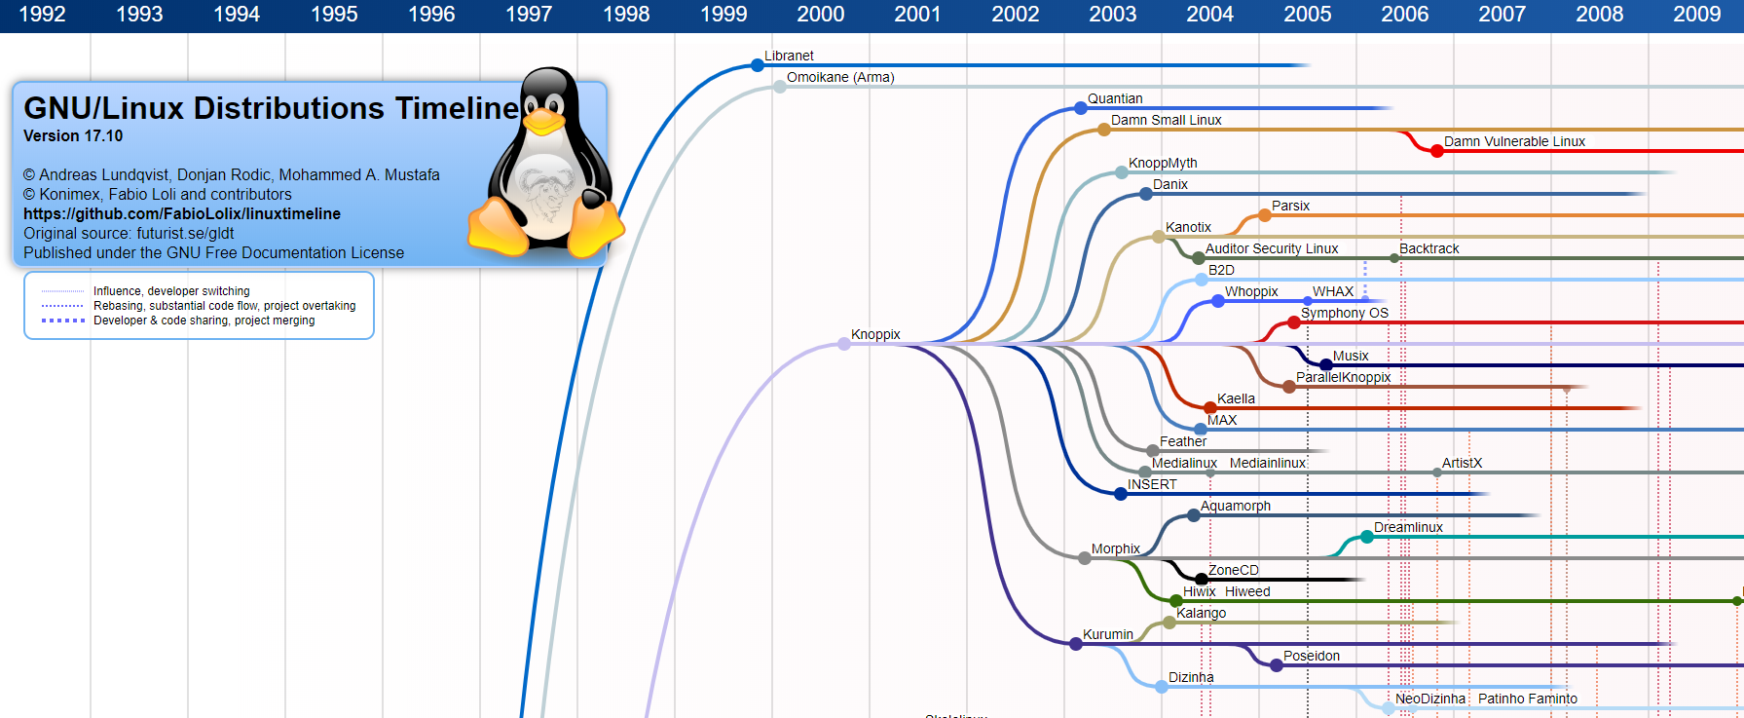
Linux Distribution Development Timeline

Slide 11
Linux Shells

Slide 12
Linux Shells
Access to Linux kernel and user spaces can be accomplished through a CLI
Linux Shell Examples:
“Bourne Shell” (bash)
“C Shell” (csh)
“TENEX Shell” (tcsh)
“Z Shell” (zsh)
User
Application
Shell
Shell
Application
Linux Kernel
System Hardware

Slide 13
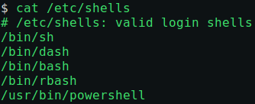
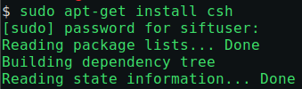
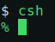
Available Shells
Each distribution has a default list of shells installed with the kernel
It will be necessary to use software package installers to add shells outside of the default list
Example
SANS SIFT, which is an Ubuntu-based Linux distribution comes with only 5 default shells
To install additional shells, utilize the packaging system

Slide 14
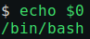
bash Shell
bash
The Bourne Again Shell (bash) includes the basic features common to all unix shells, including pipelining, here documents, command substitution, variables, control structures and wildcards
Most common default shell for user accounts
How to identify the default vs. current shell
$SHELL / $0

Slide 15
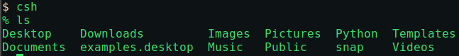
C Shell
csh
Created at by Bill Joy at the University of California, Berkeley
Objective was to create a shell with C language-like syntax that contains both control structures and expression grammar
csh also includes history and editing mechanisms, aliases, directory stacks, tilde notation, cdpath, job control and path hashing

Slide 16
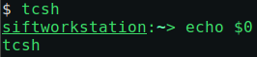
TENEX Shell
tcsh
Developed for the TENEX operating system and to be compatible with csh
Just like csh, tcsh has command-line completion and editing
Mac OS X was originally designed with tsch as the default shell, but switched to bash in Version 10.3

Slide 17
Korn Shell
ksh
Released in 1983 at AT&T Bell Laboratory by David Korn
The objective was to provide the of csh and effectiveness of bash
Ksh was released as an open source project in 1993

Slide 18
Forensic Value of Linux Shells
The Linux CLI is a powerful tool to identify forensically valuable artifacts across a Linux OS
The CLI can identify numerous artifacts including:
Bootloaders
MBR, UEFI, GRUB, INITRD
Linux Filesystem Contents
ext2, ext3, ext4
Directory / File Structure
Services & Scheduled Tasks
Installed Software and Packages
Log Files
Swap, Cache, and Persistent Data
System and User Configuration

Slide 19
Linux Commands

Slide 20
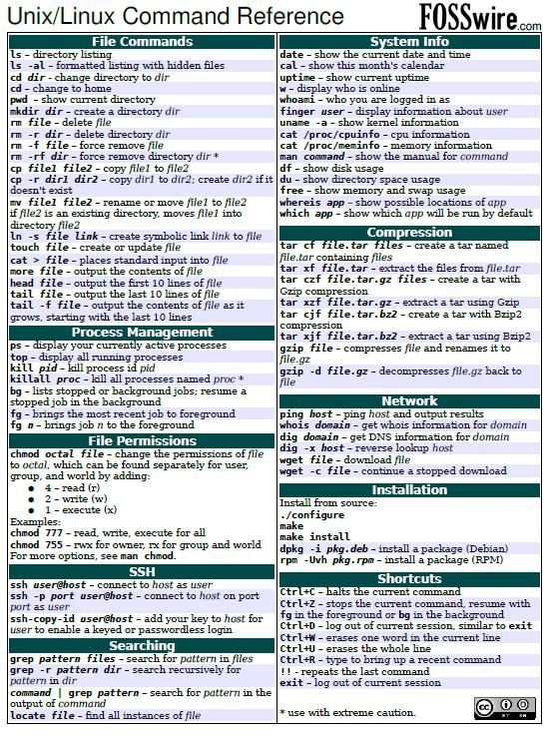
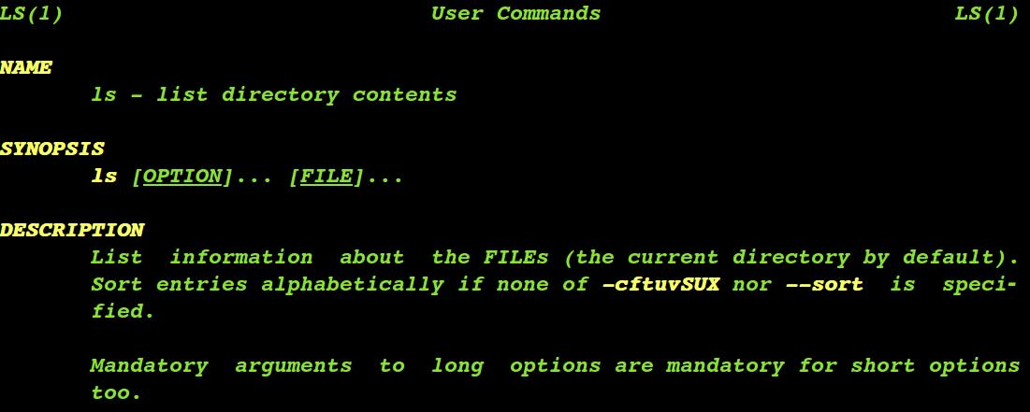
Basic Linux Commands
Introduction of basic Linux commands
whoami
hostname
uname
time
date
type
history (!!)

Slide 21
Environment Variables
Environment variables (EV) are values assigned within a shell and used by the operating system
EV’s can be displayed, set, or exported
Linux commands to identify environment variables
printenv – Print some or all of the environment
env – Print exported environment variables or run a modified environment for a program
set – Display shell variable names and values

Slide 22
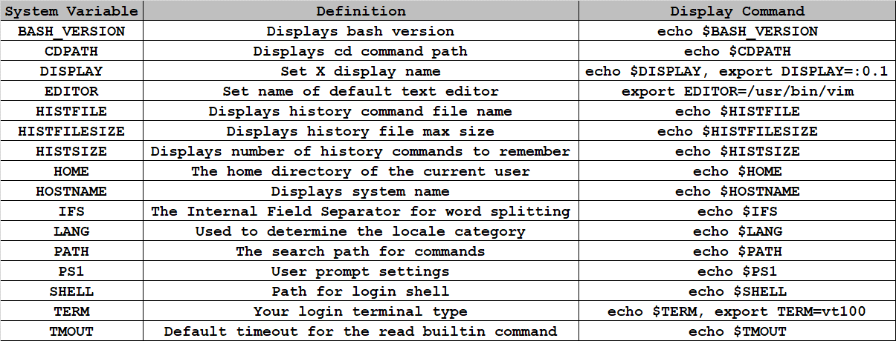
Linux Environment Variables

Slide 23
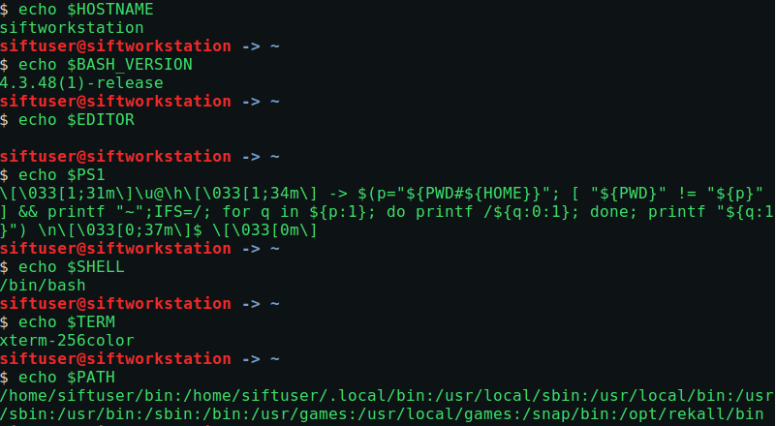
Linux Environment Variables

Slide 24
Editors
Instead of typing individual commands into the command line or interpreter, a user can use an editor to add multiple commands and save the results of the script
Some of the more well known editors are:
vi
nano
pico
emacs
Sublime text editor

Slide 25
Operators
Redirection operators allow a user to transfer input or output
Redirection Operators:
Practical Exercise:
Append to IPList1: 100.200.50.1 – 100.200.50.5
Append to Ports: 110, 143, 161, 200, 225
Operator | Description
> | Create or overwrite a file
>> | Append a file

Slide 26
Text Manipulation
Data can be manipulated with numerous Linux commands
Commands that can assist with data and file manipulation
touch
cat
tac
paste
join
sort
split
uniq

Slide 27
File / Directory Commands
A significant amount of time will be taken to focus on file commands
File commands include:
ls
cd
pwd
tail
less
more
cut
wc

Slide 28
Linux Searches and
Regular Expressions

Slide 29
Linux String Searches
There are numerous Linux static string searches that can be used to conduct forensic analysis of Linux systems:
strings
Display printable strings in file(s)
srch_strings
Displays printable strings in file(s) along with disk offset
Sleuth Kit command
srch_strings options:
-a Scan the entire file
-n Length of printable characters to extract
-t {o,x,d} Offset Location in octal, hex or decimal

Slide 30
Regular Expression and Stream Processing
Due to the limited nature of static string analysis, it is necessary to find more flexible search techniques
The following built-in Linux tools can be used to detect, filter, and manipulate text and binary data:
grep
Global Regular Expression Printer
awk
Shell scripting language to manipulate and filter data
sed
Stream editor used to manipulate and filter text from files or pipelines

Slide 31
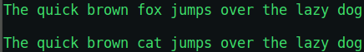
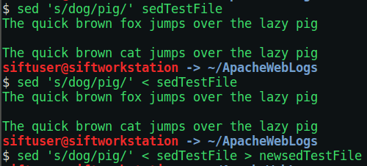
sed Substitution
Stream editor is used to manipulate and filter text from files or pipelines
Original Text
How to read the command: Use sed to substitute the word dog with the word pig in file sedTestFile
Only outputs the changes, the original file is unchanged
How to read the command: Use sed to substitute the word dog with the word pig from the redirected input of the file sedTestFile
Only outputs the changes, the original file is unchanged
Effectively the same as the first command
How to read the command: Use sed to substitute the word dog with the word pig from the redirected input of the file sedTestFile and direct the output to file newsedTestFile

Slide 32
Regular Expressions for Forensics
Instead of scanning throughout a directory, file, or any object with static signatures, regular expressions provide powerful pattern matching mechanisms
Some common individual data artifacts found with regular expressions during a forensics investigation:
File extensions
Uniform Resource Locators (URLs)
Social Security Numbers
MAC Addresses
IP Addresses
Credit Cards
Email Addresses
Phone Numbers
Regular expression and stream processing can be expanded to aid in the following activities:
Log Analysis
Intrusion Detection
Malware Detection

Slide 33
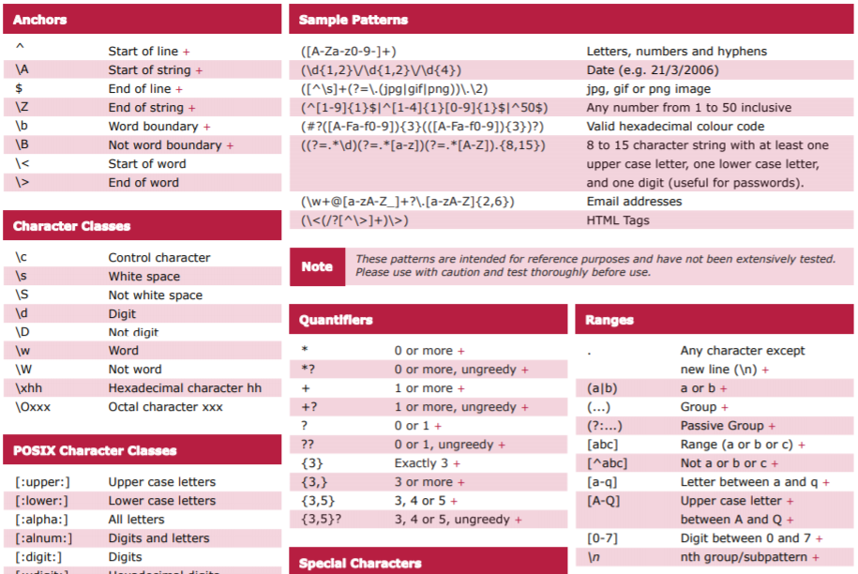
Regular Expression Reference Guide

Slide 34
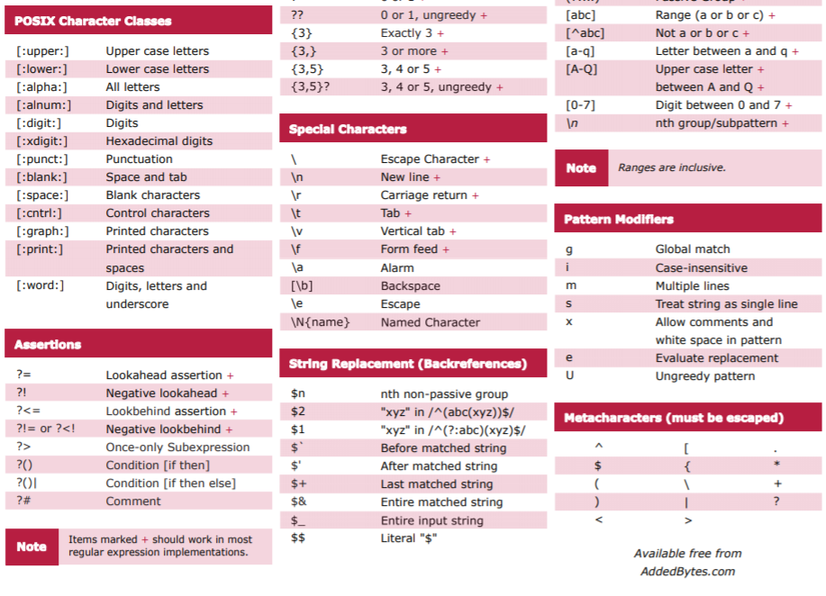
Regular Expression Reference Guide

Slide 35
File Extensions
Specify the most commonly used file extensions and
.DOC Microsoft Word Document
.DOCX Microsoft Word Open XML Document
.LOG Log File
.MSG Outlook Mail Message
.ODT OpenDocument Text Document
.CSV Comma Separated Values File
.DAT Data File
.RTF Rich Text Format File
.TEX LaTeX Source Document
.TXT Plain Text File
Build a regular expression to identify specific file types
grep -Eri '\.(docx?|log|msg|odt|csv|dat|rtf|tex|txt)' /home
How to read this regular expression:
A general regular expression that is case insensitive and recursively searches the home directory for strings containing a “.” followed by either doc or docx, log, msg, odt, csv, dat, rtf, tex, or txt

Slide 36
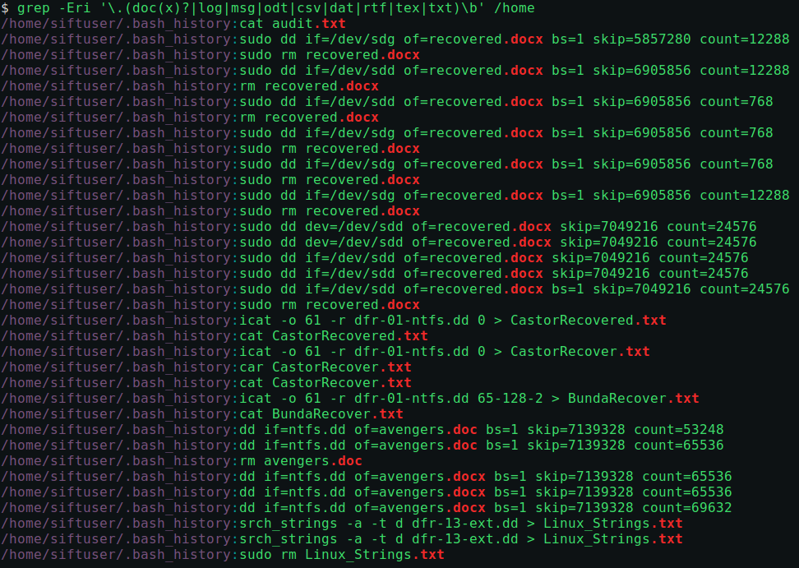
File Extensions GREP Example

Slide 37
Uniform Resource Locator
During a forensics investigation there will numerous web artifacts that need to be collected
We can make use of protocol format, IP, domain, and port information to create regular expressions
Known high level domains
.com, .org, .net, .mil, .gov, .edu
Tailor the search for known Linux directories
$HOME/.mozilla/firefox
$HOME/.config/chromium
Build a regular expression to identify specific file types
grep -Eroi 'https?:\/\/[a-zA-Z0-9._-]+(\/?)*' $HOME/.mozilla/firefox
How to read this regular expression:
A general regular expression that is case insensitive and recursively searches the Firefox directory for strings containing either “http://” or “https://” with 1 or more groupings of the character set [a-zA-Z0-9._-] followed by either nothing or a “/”

Slide 38
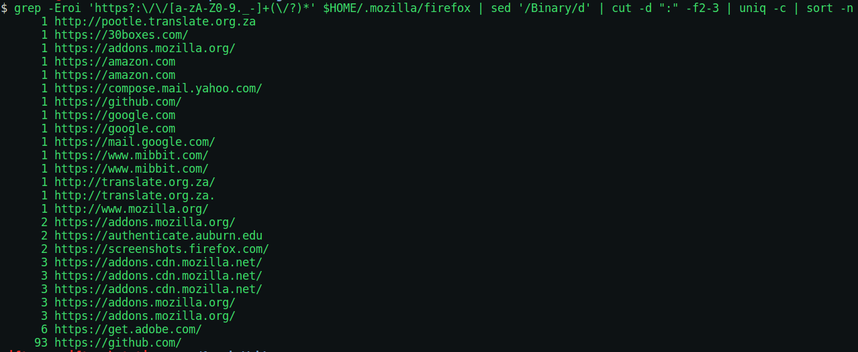
URL Filter
The original grep search filters out known URLs, but results still need to be processed
The use of stream editor and built-in functions can be used to provide a final high level domain analysis:
grep -Eroi 'https?:\/\/[a-zA-Z0-9._-]+(\/?)*' $HOME/.mozilla/firefox
sed '/Binary/d’
cut -d ":" -f2-3
uniq –c
sort -n

Slide 39
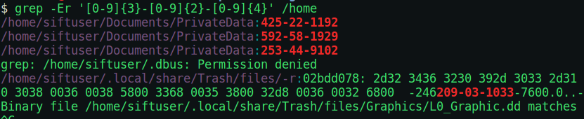
Social Security Numbers
Personally Identifiable Information (PII) may be exfiltrated during a breach and using a regular expression can assist in finding key artifacts including SSNs
SSN formats are well known
XXX-XX-XXXX
Build a regular expression to identify SSNs stored on the system:
grep -Er '[0-9]{3}-[0-9]{2}-[0-9]{4}' /home
How to read this regular expression:
Create a general regular expression that recursively searches the home directory for strings that start with three consecutive digits followed immediately by a “-”, followed by two consecutive digits followed by a “-”, followed by four consecutive digits
Test the regular expression search

Slide 40
Network Information
There are numerous network related artifacts that can be collected during a forensic analysis
All 7 of the OSI layers have known formats that can be provide regular expression filters
The Data Link and Network Layers can provide MAC and IP address information
MAC Address: XX:XX:XX:XX:XX:XX (Hexadecimal Values)
IP Addresses: XXX.XXX.XXX.XXX (0 – 255 for each octet)
Identify known commands and locations for network related data
ifconfig
arp
netstat
/etc/resolv.conf – DNS Server List
/etc/hosts – Local IP Resolution
/etc/nsswitch.conf - Name Service Switch Configuration File
/etc/network/interfaces – Network Interface Configuration

Slide 41
Network Regular Expressions – File Based
MAC Address Search:
grep -Eri '\b([0-9a-f]{2}:){5}[0-9a-f]{2}\b' /etc
How to read this regular expression:
Create a general regular expression that recursively searches the etc directory for two case insensitive hexadecimal values at the start of a word boundary, followed immediately by a “:” that are in 5 groups, followed by two consecutive hexadecimal values at the word boundary end
IP Address Search:
grep -Er '([0-9]{1,3}\.){3}[0-9]{1,3}\b' /etc
How to read this regular expression:
Create a general regular expression that recursively searches the etc directory for three digit values followed by a “.” that are in three groups, followed immediately by one to three digits at the word boundary end

Slide 42
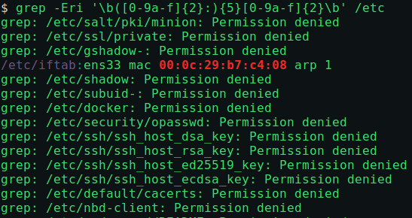
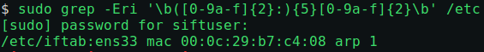
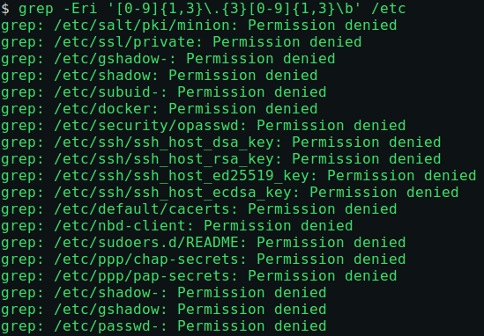
Network Regular Expressions – File Based
Non-Elevated Privileges
Elevated Privileges

Slide 43
Network Regular Expressions – Command Based
MAC Address Search:
ifconfig –a | grep -Eri '\b([0-9a-f]{2}:){5}[0-9a-f]{2}\b'
arp –a | grep -Eri '\b([0-9a-f]{2}:){5}[0-9a-f]{2}\b'
How to read this regular expression:
Create a general regular expression that recursively searches the etc directory for two case insensitive hexadecimal values at the start of a word boundary, followed immediately by a “:” that are in 5 groups, followed by two consecutive hexadecimal values at the word boundary end
IP Address Search:
ifconfig | grep -Er '([0-9]{1,3}\.){3}[0-9]{1,3}' /etc
How to read this regular expression:
Create a general regular expression that recursively searches the etc directory for three digit values followed by a “.” that are in three groups, followed immediately by one to three digits at the word boundary end

Slide 44
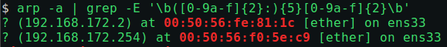
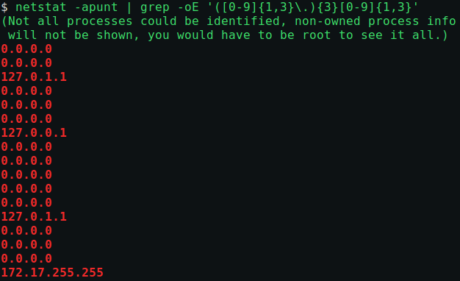
Network Regular Expressions – Command Based
Additional commands can be used to help filter, sort, and uniquely identify results

Slide 45
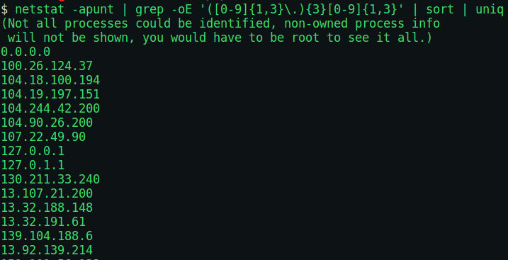
Network Regular Expressions – Command Based
To identify unique IP addresses communicating with the host:
netstat -apunt | grep -Er '([0-9]{1,3}\.){3}[0-9]{1,3}’ | sort | uniq
This search will not filter out local, loopback, or APIPA addresses
A follow on search can be used to store IP Addresses for later analysis

Slide 46
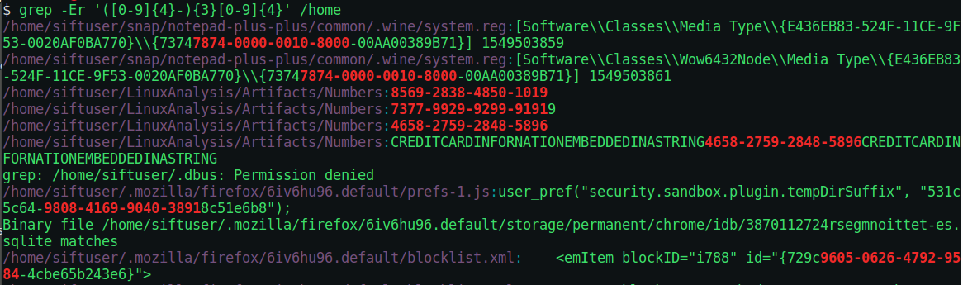
Credit Card Regular Expressions
Credit card formats are well known
XXXX-XXXX-XXXX
Build a regular expression to identify SSNs stored on the system:
grep -Er '([0-9]{4}-){3}[0-9]{4}' /home
How to read this regular expression:
A general regular expression that recursively searches the home directory for strings that start with a grouping of four consecutive digits followed immediately by “-” and immediately followed by four consecutive digits
Test the regular expression search
Sometimes things don’t work as expected:
Regular expressions may not be the best solution for detection

Slide 47
Email Address Regular Expressions
Known high level domains
.com, .org, .net, .mil, .gov, .edu
Tailor the search for known mail application directories
/home, /opt
Build a regular expression to identify specific file types
grep -Eri '[A-Za-z0-9\._%\+\-]+@[A-Za-z0-9\.%\+\-]+\.(com|org|net|mil|gov|edu)' /home /opt
How to read this regular expression:
A general regular expression that is case insensitive and recursively searches the home directory for a string that has at least 1 printable character before the “@” symbol followed immediately by at least 1 printable character, followed by a “.” and the high level domain

Slide 48
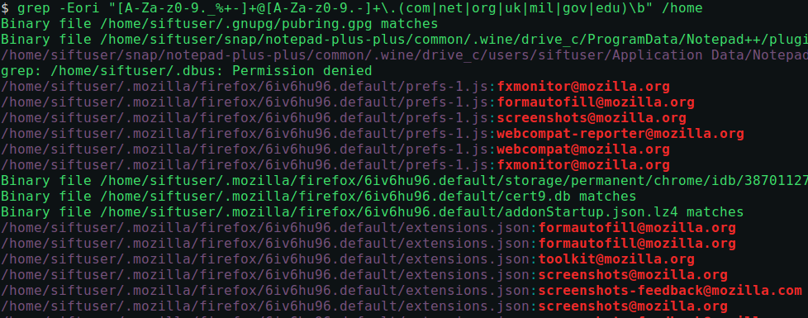
Email Address Regular Expressions Example
The results of this search can be very helpful if you are trying to collect contact information for later use or testing

Slide 49
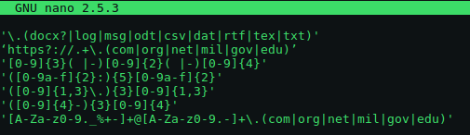
Combining Regular Expressions
Instead of searching for single regular expressions at a time, the generated regular expressions can be added to a file and referenced
Example of file with added regular expressions:
Regular expression search using a regular expression list:
grep –Erif <RegularExpressionFile> /home
How to read this regular expression:
A general regular expression that is case insensitive, recursively searches the home directory, and uses the file named <RegularExpressionFile> to match different regular expressions

Slide 50
Linux File System Analysis

Slide 51
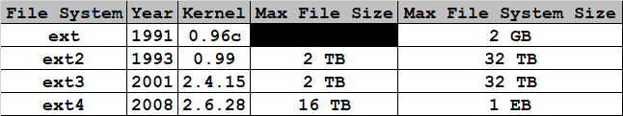
extX File System Details
Just as with the file systems that we have learned about up to this point, the extended file system has a specific structure to store data
One block in an extX file system is 1024 bytes
The extended file system is composed of two structures
Boot Block
A boot block is 1 block in size
Block Groups
Block groups are composed of six structures
Super Block
Group Descriptor
Data Block Bitmap
Inode Bitmap
Inode Table
Data Blocks

Slide 52
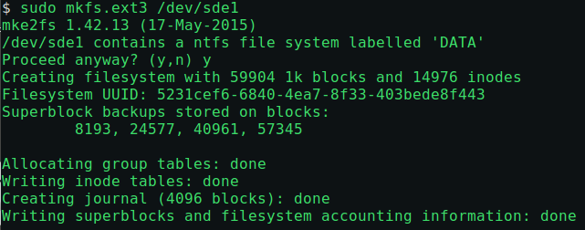
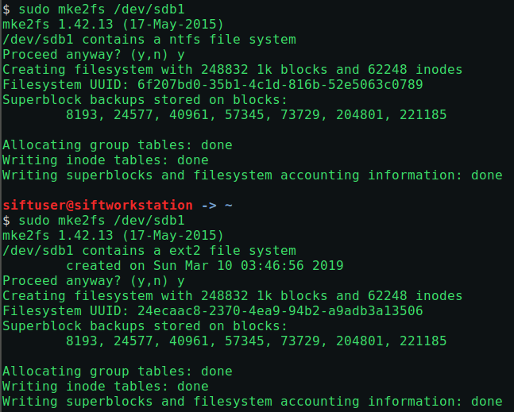
Create ext2/3 File System
Utilize same process learned during FAT and NTFS file system creation can be used without the need to modify the partition type since the default partition is Linux
fdisk
In contrast to the mkfs command, formatting of the extX file system can be accounted for with
mke2fs (ext2)
mke2fs –j (ext3)

Slide 53
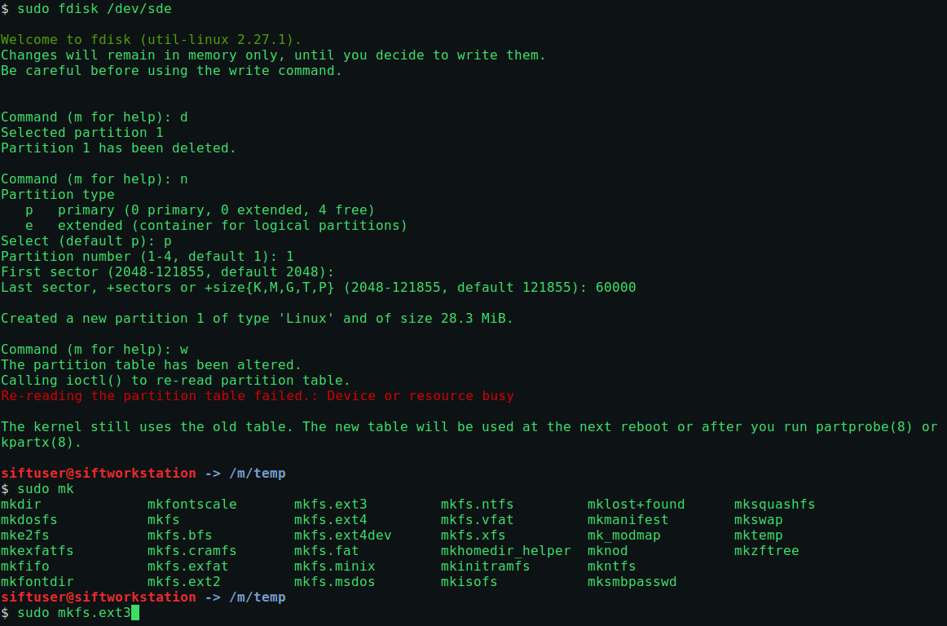
Create ext3 Filesystem

Slide 54
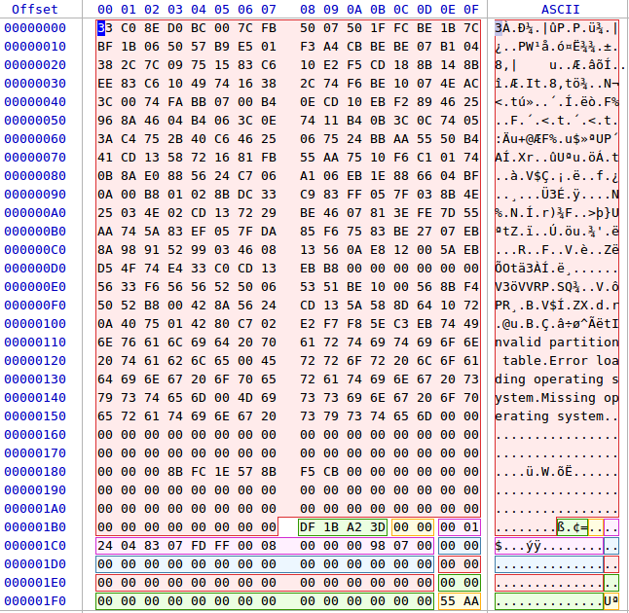
Disk Boot Sector
As with other file systems, we can use the disk boot sector to find the start of the partition
How many partitions are on the following disk?
What is the file system ID for the partition?

Slide 55
Disk Boot Sector
How many partitions are on the following disk?
1 partition
What is the file system ID for the partition?
0x83 => Linux

Slide 56
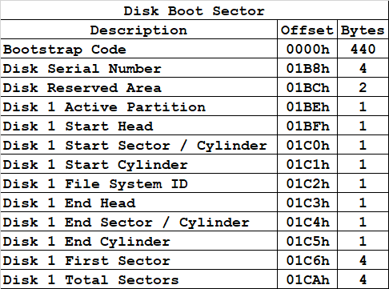
extX Partiton
Disk Serial Number: 0xDF1BA23D
Reserved: 0x0000
Active Partition: 0x00
Start Head: 0x01
Start Sector / Cylinder: 0x24
Start Cylinder: 0x04
File System ID: 0x83 => Linux
End Head: 0x07
End Sector / Cylinder: 0xFD
End Cylinder: 0xFF
First Sector: 0x00000800
Total Sectors: 0x00079800

Slide 57
extX File System Structure
If we jump into the start of the extX file system we will notice a structure that includes the following components:
Boot Block
Block Group
Super Block
Group Descriptors
Data Block Bitmap
Inode Bitmap
Inode Table
List of file inode numbers
Data Blocks
Where the contents of files reside
1 Block
Boot
Block
Block
Group 0
Block
Group N
Super
Block
Group
Descriptors
Data Block
Bitmap
Inode
Bitmap
Inode
Table
Data
Blocks
1 Block
N Blocks
1 Block
1 Block
N Blocks
N Blocks

Slide 58
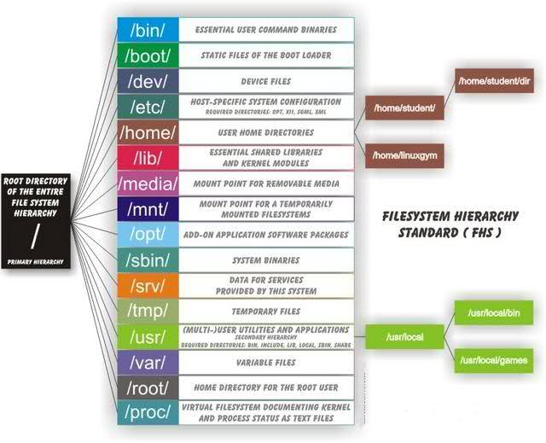
Linux Directory Structure

Slide 59
Linux File Types
Since each object in Linux is considered a file, it is helpful to use built-in functions to identify different file types
When identifying permissions on each object, the file types that can be observed are:
- : regular file
d : directory
c : character device file
b : block device file
s : local socket file
p : named pipe
l : symbolic link
Information relative to Linux files can be achieved with the following commands:
ls
stat
file

Slide 60
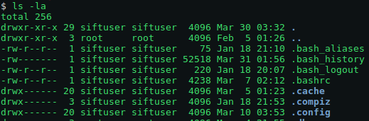
Directory Listing
Unix and Linux operating systems were configured with multi-user systems in mind
When a new user is created on a system, permissions are created to allow and limit access to other system resources
Linux directory listing example:
Mode
Owner
Group
File
Size
Time
Modified
Filename

Slide 61
Linux Mode
Mode
Owner
Group
File
Size
Time
Modified
Filename
File Type
“World” Permissions
Owner Permissions
Group Permissions

Slide 62
Linux Permissions
Read, Write, Execute
File Type
“World” Permissions
Owner Permissions
Group Permissions

Slide 63
Linux Forensics & Permissions
During a forensic analysis on a Linux system it is necessary to determine some important permission information:
Are the systems owned by the organization or is the analysis of an external organization?
What permission level does the forensic analyst have?
Is a system administrator available during the analysis?
Will there be a need to elevate privileges?
How are privileges elevated?

Slide 64
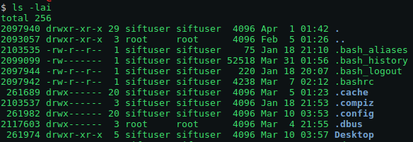
Linux inodes
Every object created within a Linux file system is assigned with an inode value which specifies all file attributes
Attributes within an inode include:
File types
Permissions
User Identification Value (UID)
Group Identification Value (GID)
Filesize
Timestamps
Deletion Time
Links
Soft Links
Hard Links
File storage location

Slide 65
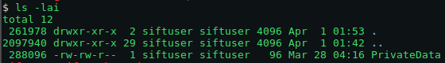
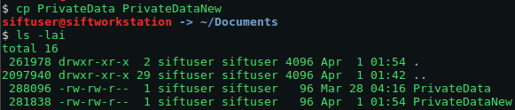
Linux inodes Generation & Modification
Creating a new Linux file system object
A new inode is created
Copying a Linux file system object
The inode of the copied file is assigned with the first available inode number or incremented
Deleting a Linux file system object
The inode value of the file is reset to 0 and the previous inode value is available for reuse
In ext2 and ext3, the file contents are still available, but in ext4 the file contents are zeroed out

Slide 66
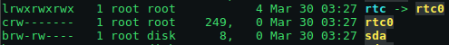
file Command
Each object in Linux is considered a file
The file command provides information about different file types:
Regular: -
Directory: d
Character device: c
Block device: b
Local socket: s
Named pipe: p
Symbolic link: l

Slide 67
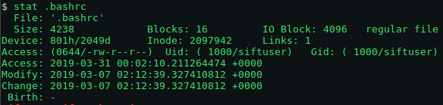
stat Command
The list file can provide good basic information about active files and this can be augmented with the stat command which displays file or file system status
Some of the more useful stat options include:
-L, --dereference
Follows links associated to the file
-f, --file-system
Identifies file system status instead of file status
-c --format=FORMAT
use the specified FORMAT instead of the default; output a newline after each use of FORMAT

Slide 68
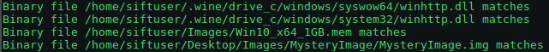
Regular File Types
There are different types of regular files
Readable
Binary
Image
Compressed
There will be cases when regular expression searches result in successful matches, but the matches will be on binary files
Methods to find matches within binary files
grep -a <BinaryFileName>
bgrep <BinaryFileName>

Slide 69
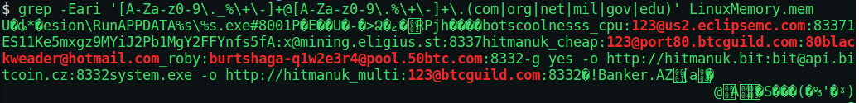
Binary File Search
Example of binary search on main memory
grep -a <BinaryFileName>

Slide 70
Linux Web Server Forensics

Slide 71
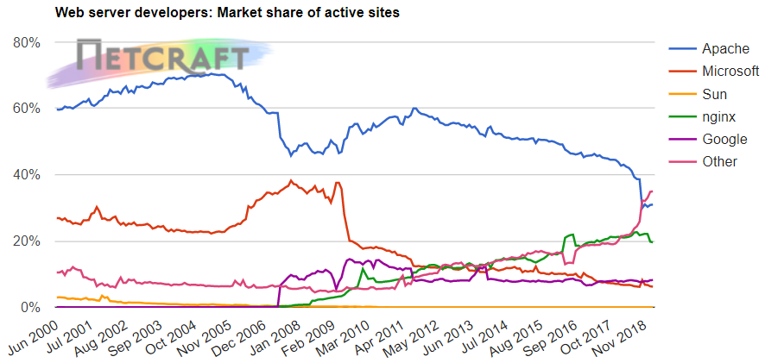
Linux Web Server Forensics
With an understanding of Linux file system structure, we can apply our knowledge to a specific forensics application
Significant information can be identified within Linux systems that are configured as web servers
Some of the more common Linux-based web servers include:
Apache HTTP Server
Tomcat
NGINX
Node.js
Lighttpd

Slide 72
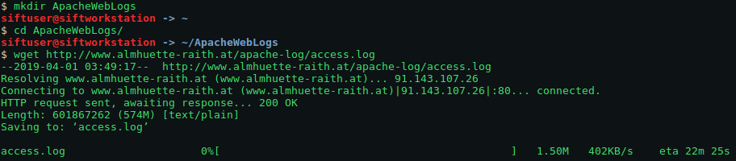
Apache Web Servers
The specific distribution of Linux used will depend on the location of error and access logs for the web server
In the case of Apache, the location of error logs is found in the following locations depending on the distribution:
RHEL / Red Hat / CentOS / Fedora
/var/log/httpd/error_log
Debian / Ubuntu
/var/log/apache2/error.log
FreeBSD
/var/log/httpd-error.log
For information specific to Apache configurations, the following searches can be used:
grep ErrorLog /usr/local/etc/apache22/httpd.conf
grep ErrorLog /etc/apache2/apache2.conf
grep ErrorLog /etc/httpd/conf/httpd.conf
There are numerous open resources for Apache web logs
wget http://www.almhuette-raith.at/apache-log/access.log
wget https://raw.githubusercontent.com/elastic/examples/master/Common%20Data%20Formats/apache_logs/apache_logs

Slide 73
Apache Web Access Log Components
Once access logs have been identified, it is important to determine the structure of the logs which can be classified as common, combined, or custom
An example of common log format:
Requesting IP Address
Client Identifier (Normally “-”)
User Identifier (Normally “-”)
Timestamp - Date, Time, and Time Zone the Request Was Received From
Client HTTP Request
HTTP Status Code
Object Size in Bytes
Combined log format:
Requesting IP Address
Client Identifier (Normally “-”)
User Identifier (Normally “-”)
Timestamp - Date, Time, and Time Zone the Request Was Received From
Client HTTP Request
HTTP Status Code
Object Size in Bytes
Referer
User Agent
Unused
109.169.248.247 client bill [12/Dec/2015:18:25:11 +0100] "GET / HTTP/1.1" 200 4263
109.169.248.247 client bill [12/Dec/2015:18:25:11 +0100] "GET / HTTP/1.1" 200 4263 "-" "Mozilla/5.0 (Windows NT 6.0; rv:34.0) Gecko/20100101 Firefox/34.0" "-"

Slide 74
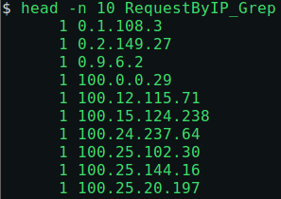
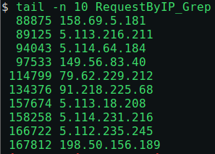
Apache Web Access Log Analysis - grep
We can make use of the access log format to develop a set of search criteria
We will start with a basic search of IP addresses interacting with the Linux web server and make use of both the sort and unique command
grep -oE '([0-9]{1,3}\.){3}[0-9]{1,3}' access.log | sort | uniq -c | sort -n > RequestByIP_grep
109.169.248.247 client bill [12/Dec/2015:18:25:11 +0100] "GET / HTTP/1.1" 200 4263 "-" "Mozilla/5.0 (Windows NT 6.0; rv:34.0) Gecko/20100101 Firefox/34.0" "-"
Regular Expression for IP Address
Sort IPs
Sort By Ascending Order
File
Count Unique Values
Redirect Output
to File

Slide 75
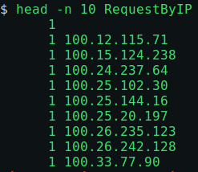

Apache Web Access Log Analysis - cut
We can make use of the access log format to develop a set of search criteria
We will start with a basic search of IP addresses interacting with the Linux web server and make use of both the sort and unique command
cut –d “ “ –f1 access.log | sort | uniq -c | sort -n > RequestByIP_cut
109.169.248.247 client bill [12/Dec/2015:18:25:11 +0100] "GET / HTTP/1.1" 200 4263 "-" "Mozilla/5.0 (Windows NT 6.0; rv:34.0) Gecko/20100101 Firefox/34.0" "-"
Field #1
Sort IPs
Sort By Ascending Order
Space Delimiter
File
Count Unique Values
Redirect Output
to File

Slide 76
Client HTTP Request Methods
When conducting forensic analysis on Linux-based web servers, access logs can provide significant detail on web server interactions
Originally all HTTP technical configurations were defined by Request for Comment 2616, but was replaced by RFCs 7230-7237:
OPTIONS
Provides information on the methods and options supported by the web server
GET
Used to retrieve resources from the web server
HEAD
Provides web server header information
POST
Sends user-generated data to the web server
Web server decides what to do with the user-generated data
PUT
Creates or overwrites a resource at a particular URL on the web server
Web server is told what to do with the user-generated data
DELETE
A request to delete a resource at a particular URL
TRACE
A debugging method that returns back the original request
CONNECT
Establishes a TCP connection with the web server

Slide 77
Client HTTP Request Methods
Using the access log format again, lets build a search string to identify the number of each type of request in our access log
109.169.248.247 client bill [12/Dec/2015:18:25:11 +0100] "GET / HTTP/1.1" 200 4263 "-" "Mozilla/5.0 (Windows NT 6.0; rv:34.0) Gecko/20100101 Firefox/34.0" "-"
Let’s answer some key questions:
Should we use grep or cut command to find the request methods or can both be used?
What would be a effective grep search to find the total number of HTTP request methods found in the access log?

Slide 78
Client HTTP Request Methods
Using the access log format again, lets build a search string to identify the number of each type of request in our access log
109.169.248.247 client bill [12/Dec/2015:18:25:11 +0100] "GET / HTTP/1.1" 200 4263 "-" "Mozilla/5.0 (Windows NT 6.0; rv:34.0) Gecko/20100101 Firefox/34.0" "-"
Let’s answer some key questions:
Should we use grep or cut command to find the request methods or can both be used?
Both can be used
What would be a effective grep search to find the total number of HTTP request methods found in the access log?
grep -oiE '(options|head|get|post|put|delete|trace|connect)' access.log | sort | uniq -c | sort –n

Slide 79

HTTP Request Method Results
What are some immediate forensics results that we can gather from the results shown below?
What are some searches that can be conducted to find potentially malicious web server activity?

Slide 80
Follow-On HTTP Request Method Searches
What should be the correct format of any HTTP request method? Where is this information found?
Let’s build a search that finds all request methods that are not formatted correctly…
Create either a bash or Python script to generate incorrectly formatted HTTP methods
Try to use as many characters as possible to generate a unique search
It will become clear after running the search if there are potentially malicious requests being run against the web server
grep -E '"(gEt|GEt|pUt|Put|Trace|Delete|puT|Options|Post|delete|options|Get|Connect|trace|post|Head|put|connect|get|head) ' access.log

Slide 81


Follow-On HTTP Request Method Searches
There will be cases when HTTP requests contain non request method content
We can use the output of the cut command on the fields that contain HTTP Method information and search for non-HTTP Method outputs:
cut -d " " -f6-7 access.log | grep -oiE '^".* \/' | sort | uniq -c | sort -n

Slide 82
HTTP Request Method Encoding
HTTP requests can be modified with different encoded strings which makes direct analysis difficult
Although there are various encoding schemes for HTTP requests, some of the more common schemes include:
URL Encoding
Unicode Encoding
Hexadecimal Encoding
Base64 Encoding
HTML Encoding
The popular Base64 encoding scheme, as with many communication protocols, can be determined with the use of a Request for Comment; RFC 4648
An effective regular expression search for Base64 encoded strings in our Linux web server access log will be:
grep -Ei '=[0-9a-zA-Z+/]{20,}={0,2}'
Base64 regular expression explanation:
A case insensitive regular expression that searches for at least 1 character from the character sets a-z, 0-9, +, or / followed immediately by one or two “=“

Slide 83
HTTP Request Method Encoding
HTTP requests can be modified with different encoded strings which makes direct analysis difficult
Although there are various encoding schemes for HTTP requests, some of the more common schemes include:
Base64 Encoding
URL Encoding
Unicode Encoding
Hexadecimal Encoding
HTML Encoding
The popular Base64 encoding scheme, as with many communication protocols, can be determined with the use of a Request for Comment; RFC 4648
An effective regular expression search for Base64 encoded strings in our Linux web server access log will be:
cut -d '"' -f2 access.log | grep -Ei '=[0-9a-zA-Z+/]{20,}={0,2}' | sort | uniq -c | sort -n
Base64 regular expression explanation:
A case insensitive regular expression that searches for at least 1 character from the character sets a-z, 0-9, +, or / followed immediately by zero, one, or two “=“

Slide 84


HTTP Request Method Encoding

Slide 85

HTTP Request Method Encoding
We can make a minor modification to the command by outputting the matched values and storing to decode all potential Base64 values
cut -d '"' -f2 access.log | grep -Eoi '=[0-9a-zA-Z+/]{20,}={0,2}' | sort | uniq -c | sort –n > PotentialBase64
The returned values may be Base64, but testing indicates some of them may be false positives
Notice that there is leading whitespace before the number of events and also followed by a “ =“

Slide 86
Mass Decoding
So we now have a file that contains what we think is a large number of Base64 encoded strings, but we are not sure
grep is probably not the best tool in this case because it is not normally used for substation; sed works better
cat PotentialBase64
sed -e 's/^[ \t]*//' PotentialBase64
sed -e 's/^[ \t]*//' PotentialBase64 | sed -E 's/[0-9]{1,4} =//’
sed -e 's/^[ \t]*//' PotentialBase64 | sed -E 's/[0-9]{1,4} =//’
> CleanedPotentialBase64
We now have a listing of “cleaned” Base64 encoded strings so we can now use the bash built in base63 function to decode each string to see what we get
while read line; do printf "$line \n"; printf "\n"; done < CleanedPotentialBase64
while read line; do printf "The Base64 Decoding for $line is:\n"; printf $line | base64 -d; printf "\n\n"; done < CleanedPotentialBase64
while read line; do printf "The Base64 Decoding for $line is:\n"; printf $line | base64 -d; printf "\n\n"; done < CleanedPotentialBase64 2> /dev/null > DecodedBase64

Slide 87

HTTP Status Codes
In addition to HTTP request information, access logs also track the responses from the server
The responses are generally used to help users identify if content resides at the locations they have searched for, however this can also provide significant forensic information
Web server status codes fall into 5 categories:
1XX - Information
2XX – Successful
3XX – Redirection
4XX – Client Error
5XX – Server Error
To identify all HTTP status codes collected by the access log:
grep -Eo '" [0-9]{3} [0-9].+ "' access.log | cut -d " " -f2 | sort | uniq -c | sort -n
4XX - Client Errors
400 – Bad Request
401 – Unauthorized
403 – Forbidden
404 – Not Found
406 – Not Acceptable
412 - Precondition Failed
5XX - Server Errors
500 – Internal Server Error
501 – Not Implemented

Slide 88


HTTP Status Errors
Searching for client bad request and unauthorized errors:
grep -Eo '" [0-9]{3} [0-9].+ "' access.log | grep -E '" 401 "'

Slide 89
HTTP Referrer
The HTTP referrer field contains the URL that the requester was on prior to coming to the current page
Collecting HTTP Referrer information can provide insight to how a resource was obtained
Reviewing a new access log and using our knowledge of the previous commands we can pull out HTTP referrer data:
cut -d "\"" -f4 apache_logs
cut -d "\"" -f4 apache_logs | sed '/-/d'
cut -d "\"" -f4 apache_logs | sed '/-/d' | sort | uniq -c | sort –n
cut -d "\"" -f4 apache_logs | sed '/-/d' | sort | uniq -c | sort -n | sed -e 's/^[ \t]*//' | cut -d " " -f2

Slide 90
HTTP User-Agent
The User-Agent string indicates the application software used to send requests
During a Linux web server forensics analysis, we can analyze User-Agents to see if they have been manipulated or if malware has been reused during an attack
Using the same process as before:
cut -d "\"" -f6 access.log
cut -d "\"" -f6 access.log | sort | uniq -c | sort –n

Slide 91

User-Agent Search Next Steps

Slide 92

Regular Expression Homework
Write a small report with a regular expression for each of the following artifacts and explain how each part of the regular expression works:
SSH Public Keys
LANMAN Hash
SSH Private Keys
SHA-512 Hash
Check your result against regex101 and submit your results by 10 April

Slide 93

Homework Example
The following regular expression is for detection of an email address in a particular directory of a Linux system:
grep -Eri '[A-Za-z0-9._%+-]+@[A-Za-z0-9.-]+\.(com|org|net|mil|gov|edu)' /home
This regular expression can be read as follows:
A general regular expression that is case insensitive and recursively searches the home directory for a string that has at least 1 printable character before the “@” symbol followed immediately by at least 1 printable character, followed by a “.” and the high level domain
As can be seen from regex101 the regular expression correctly matches on the first three examples since it meets the requirements above but fails on the last two since the wrong high level domain was used on one and an incorrect character was used on the other

Slide 94
References
Unix History
https://www.slideshare.net/15koolneha/ext-filesystem4
File System Forensic Analysis, Carrier, 2005
Chapter 14 & 15
ext File System History and Directory Structure
https://www.slideshare.net/15koolneha/ext-filesystem4
https://www.tecmint.com/linux-directory-structure-and-important-files-paths-explained
Linux Environment Variables
https://www.cyberciti.biz/faq/linux-list-all-environment-variables-env-command
Linux Distributions
https://upload.wikimedia.org/wikipedia/commons/1/1b/Linux_Distribution_Timeline.svg
Regular Expressions
http://e-texteditor.com
https://www.sans.org/reading-room/whitepapers/forensics/paper/33929
http://www.cbs.dtu.dk/courses/27610/regular-expressions-cheat-sheet-v2.pdf
Linux Shells
https://code.snipcademy.com/tutorials/linux-command-line/environment/shells
https://www.maketecheasier.com/understanding-korn-shell
Linux Forensic Artifacts
https://www.digitalforensics.ch/nikkel18.pdf
Linux Web Server Logs
https://blog.codeasite.com/how-do-i-find-apache-http-server-log-files

